Slide 1
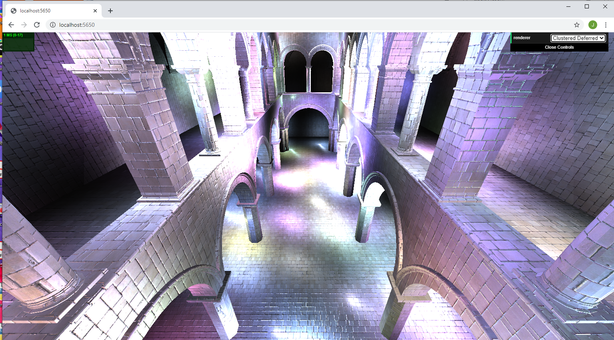
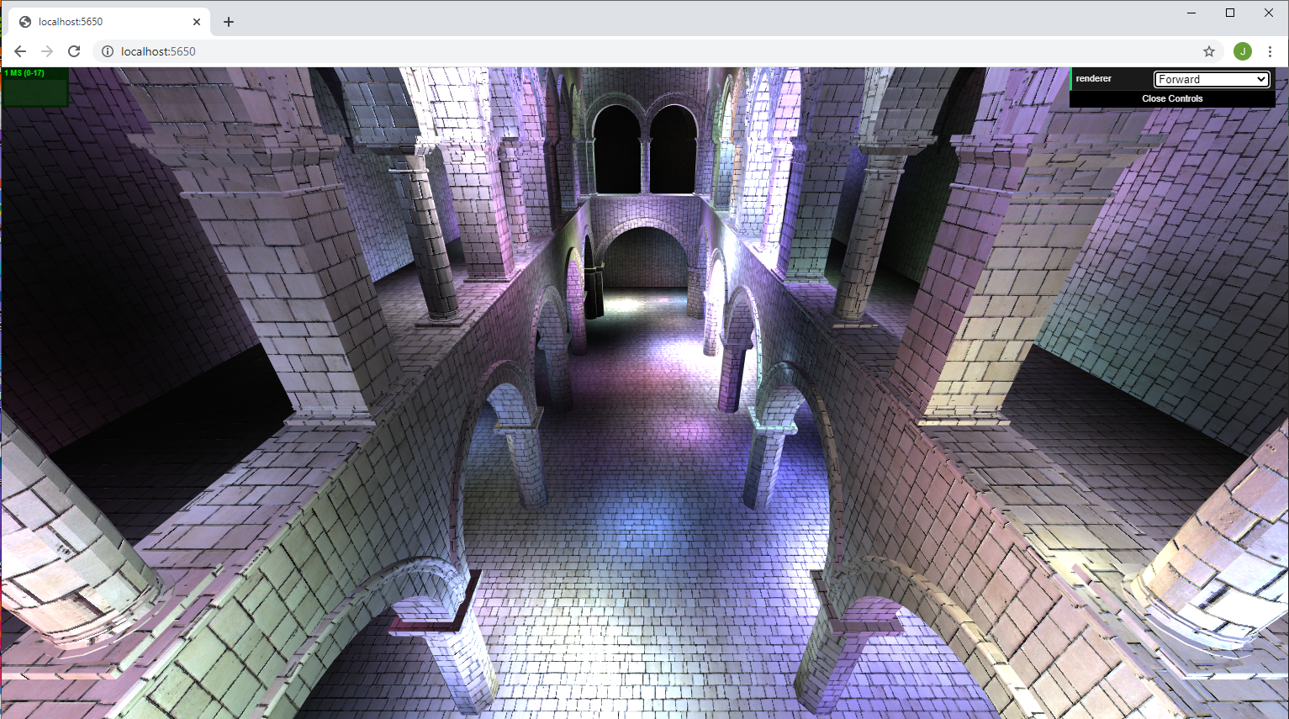
With Blinn-Phong Effect
Without Blinn-Phong Effect

Slide 2
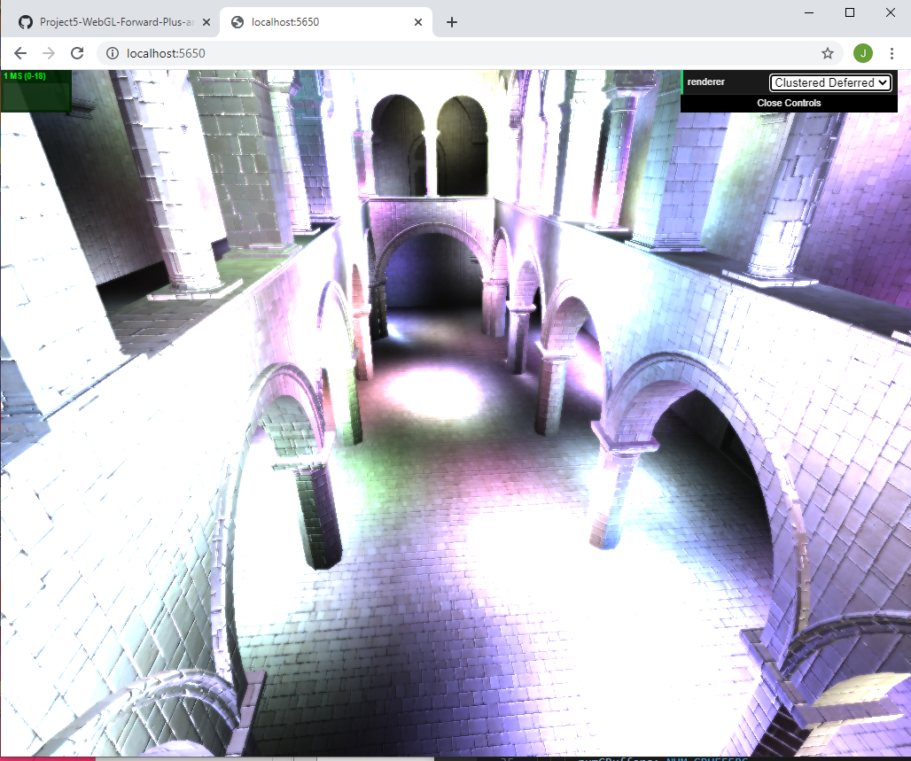
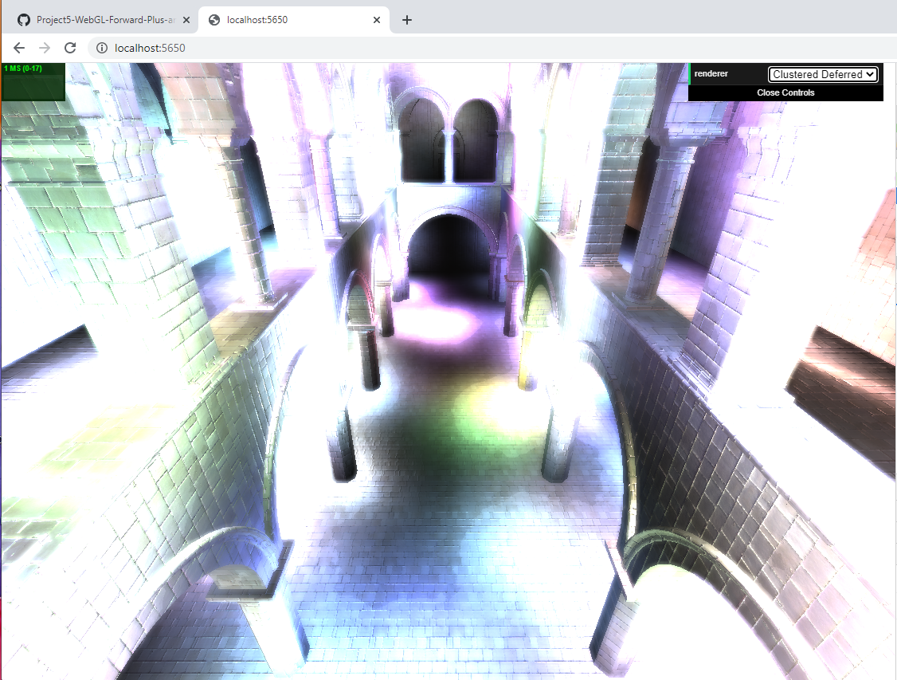
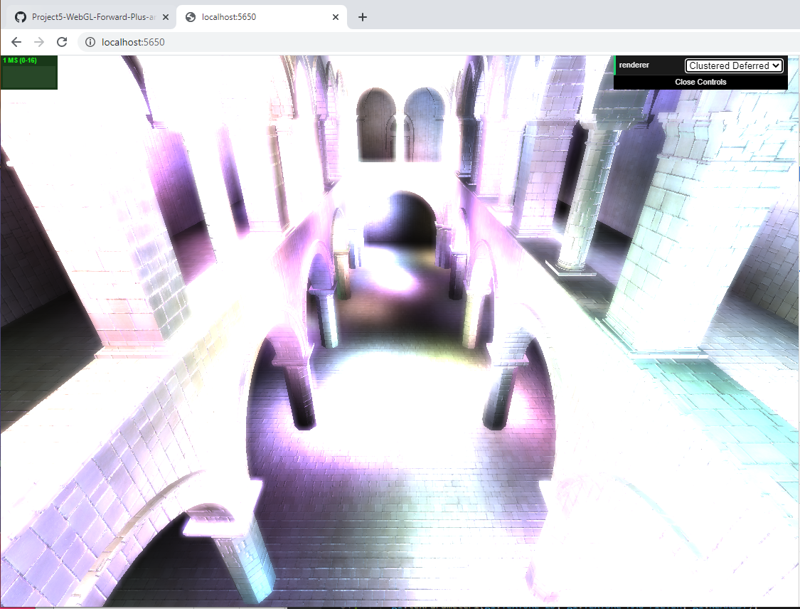
Kernel dim = 0
Kernel dim = 5
Kernel dim = 10
Kernel dim = 15

